Slide 1
Mobile OGSI.NET
Grid Computing on Mobile Devices
Presented by:
Hena Jha

Slide 2
Introduction
Why do we need Mobile OGSI.NET?
Drawbacks:
Battery constraint
Storage constraint
Network Bandwidth.

Slide 3
Features without Mobile OGSI.Net
Scenario 1
If user wishes to check stock prices while simultaneously viewing a streaming video.
Scenario 2
Speaker sharing for multimedia applications.
The user is limited to sequential viewing /sharing. With Mobile OGSI.NET ,It supports to optimize resource usage on behalf of the user.

Slide 4
Goals
To construct a platform to provide better potential for collaboration among mobile devices.
To support the above collaboration make use of collaboration between mobile device with non mobile desktops/server.
Collaboration architecture should operate on several platforms.
Collaboration Architecture must address particular characteristics of mobile devices.
Notes:
1)i.e., we wish to facilitate various applications on a single device or multiple device, being able to work together on a particular problem.
2)Ie in order to provide mobile to mblie device collaboration ,they wanted to support this they want to achieve this by mobile to non mobile traditional workstation s and servers collaboration because mobile to desktop/server collaboration opens further possibiliteis of maximizing resource utilization and will improve user experirnce. Because while mobile device provides convinience non mobile desktos and servers can provide limitless resources and networking.
3)To enable practical mobile device collaboration mobile ogsi.net should be implemented on a widely used operationg system.
4)Characteristics of mobile devices are qulaity and fluctuation of network when the user moves with the device,other resource issues are porcessing power, storage capacity ,finite battery.

Slide 5
Mobile OGSI.NET
OGSI
Open grid services specification.
Gives a formal and technical specification of what a grid service is
Mobile OGSI.NET is based on OGSI specifications.

Slide 6
Mobile OGSI.NET
Why .NET?
Mobile OGSI.NET is Implemented on top of .NET compact framework
Mobile OGSI.NET acts as an intermediary software layer between the application and the operating system.

Slide 7
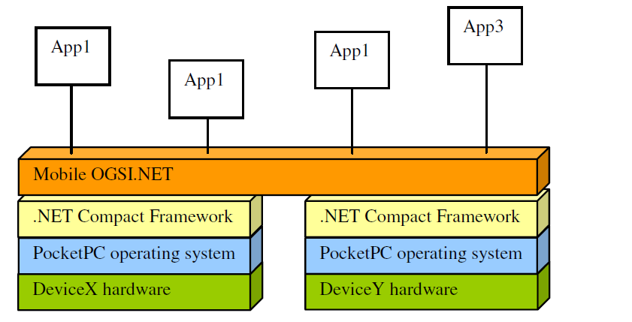
Overview

Slide 8
Mobile OGSI.NET Architecture
Mobile Web Server
Grid Service module
Grid Services/Factories/Classes

Slide 9
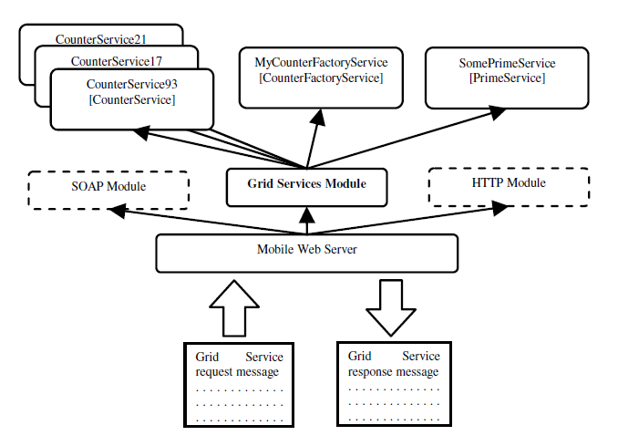
Figure 2. Architecture

Slide 10
Architecture
Mobile Web server
It handles endpoint to endpoint message reception and transmission
Grid Services Module
parses and multiplexes messages to the appropriate Grid services/classes/factories
Grid Services
Grid service handles application logic and processing.

Slide 11
Distributed services performance
Performance gain is measured in response to increased hardware resources.
First case :Single HP iPAQ runs traditional non-distributed prime searching application.
It allows to benchmark performance gains or losses.
Response time does indeed improves with multiple devices.

Slide 12
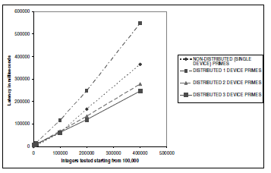
Latency

Slide 13
Battery Usage
Greater job distribution does indeed more evenly distribute battery usage than less job distribution.

Slide 14
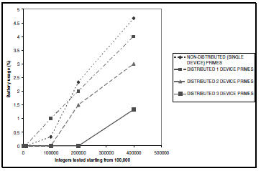
Battery usage

Slide 15
Conclusion
High performance supercomputing designs and adapted these for personal mobile devices.
Designed Mobile OGSI.NET an OGSI specification conformant grid computing hosting environment.
First to offer OGSI Grid Service hosting on small devices.
Distributed services better utilize available resources and prolong lifetime of individual devices.

Slide 16
Future Improvements.
Mobile OGSI.NET does not currently implement Grid Notifications nor security mechanisms.
Mobile OGSI.NET should port easily to other mobile and non-mobile embedded devices.

