Slide 1
Toward Loosely Coupled Programming on Petascale Systems
Presenter: Sora Choe

Slide 2
Index
Introduction…………………………………3~7
Requirements……………………………..8~12
Implementation…………………………13~17
Microbenchmarks Performance……..18~23
Loosely Coupled Applications……….24~31
DOCKS and MARS
Conclusion and Future Work…………32~34

Slide 3
Introduction
Emerging petascale computing systems
  incorporate high-speed, low-latency interconnects
  Designed to support tightly coupled parallel computations
Most of applications running on these
  have a SPMD structure
  Implemented by using MPI for interprocess communication
Goal: enable the use of petascale computing systems for task-parallel applications

Slide 4
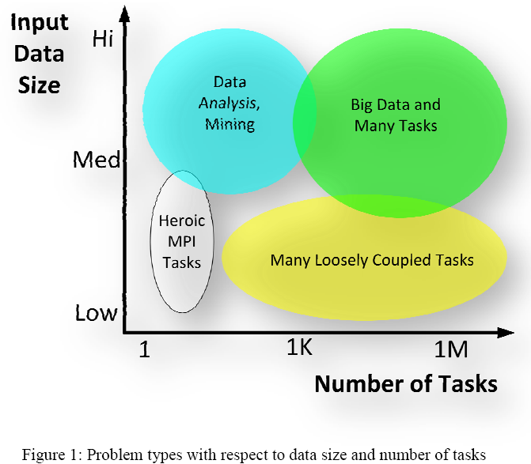
Problem Space

Slide 5
Many-Task Computing(MTC)
Many tasks that can be individually scheduled on many different computing resources across multiple administrative boundaries to achieve some larger application goal
Emphasis on using much large numbers of computing resources over short periods of time to accomplish many computational tasks
Primary metrics are in seconds
e.g. FLOPS, tasks/sec, MB/sec I/O rates
Notes:
HTC requires large amounts of computing for longer times(months and years, rather than hours and days)

Slide 6
Hypothesis
MTC applications can be executed efficiently on today’s supercomputers
A set of problems that must be overcome to make loosely coupled programming practical on emerging petascale architecture
  Local resource manager scalability and granularity
  Efficient utilization of the raw hardware
  Shared file system contention
  Application scalability
IBM Blue Gene/P supercomputer(also known as Intrepid)
Processors = cores = CPUs

Slide 7
Why Peta. Sys. For MTC Apps?
( 4 motivating factors)
The I/O subsystem of peta. systems offers unique capabilities needed by MTC applications
The cost to manage and run on peta. systems like the BG/P is less than that of conventional clusters or Grids
Large-scale systems inevitably have utilization issues
Some apps are so demanding that only peta. systems have enough compute power to get results in a reasonable timeframe, or to leverage new opportunities

Slide 8
Requirements
For large-scale and loosely coupled apps to efficiently execute on petascale systems, which are traditionally HPC systems
Required mechanisms
  Multi-level scheduling
  Efficient task dispatch
  Extensive use of caching to minimize shared infrastructure such as file systems and interconnects
Notes:
HPC: High Performance Computing

Slide 9
Multi-Level Scheduling
Essential because LRM(Cobalt) on BG/P works at a granularity of pset
  Pset: a group of 64 quad-core compute nodes and one I/O node
  Allocate compute resources from Cobalt at the pset granularity, and then make these resources available to apps at a single processor core granularity
  Made possible through Falkon and its resource provisioning mechanism

Slide 10
Multi-Level Scheduling(cont.)
Overhead of scheduling and starting resources
  Compute nodes are powered off when not in use and must be booted when allocated to a job
  Since compute nodes don’t have local disks, the boot-up process involves reading the lightweight IBM compute node kernel(Linux-based ZeptoOS kernel image, specifically) from a shared file system
  Multi-level scheduling reduces it to insignificant overhead over many jobs

Slide 11
Efficient Task Dispatch
Streamlined task submission framework
Falkon’s specialization leading higher performance
  LRMs for reservation, policy-based scheduling, accounting, etc.
  Client frameworks(workflow sys. or distributed scripting systems) for recovery, data staging, job dependency management, etc.
  2534 tasks/sec in a Linux cluster
  3186 tasks/sec on the SiCortex
  3071 tasks/sec on the BG/P
  VS
  0.5~22 jobs/sec on traditional LRMs like Condor or PBS
Notes:
High throughputs are critical in running large number of tasks on many processors as efficiently as possible

Slide 12
Extensive Use of Caching
Compute nodes on BG/P have a shared file system(GPFS) and local file system implemented in RAM(ramdisk)
For better app. scalability,
  Extensive caching of app. data using ramdisk LFS
  Minimizing the use of shared file systems
Simple caching scheme is employed for
  Static data : app. Binaries, libraries, common input
  cached at all compute nodes
  Dynamic data : input data specific for a single data
  cached on one compute node

Slide 13
Implementation
Swift and Falkon
  Swift enables scientific workflows through a data-flow-based functional parallel programming model
  Falkon light-weight task execution dispatcher for optimized task throughput and efficiency
Extensions to get Falkon to work on BG/P
  Static Resource Provisioning
  Alternative Implementations
  Distributed Falkon Architecture
  Reliability Issues at Large Scale

Slide 14
Static Resource Provisioning
An app. requests a number of processors for a fixed duration directly from the Cobalt LRM
Once the job goes into a running state and the Falkon framework is bootstrapped, the application interacts directly with Falkon to submit single processor tasks for the duration of the allocation

Slide 15
Alternative Implementations
Performance depends on the behavior of our task dispatch mechanisms
The initial Falkon implementation
  100% Java
  GT4 Java WS-Core to handle Web Services comm.
Alternative
  Reimplementation some functionality in C due to the lack of Java on BG/P
  Replace WS-based protocol with simple TCP-based protocol
  TCPCore to handle the TCP-based comm. Protocol
  Persistent TCP sockets
Notes:
TCPCore is a component to manage a pool of threads that lives in the same JVM as the Falkon dispatcher, and uses in-memory nitifications and shared objects for communication
Persistent TCP sockets to reuse connections across tasks

Slide 16
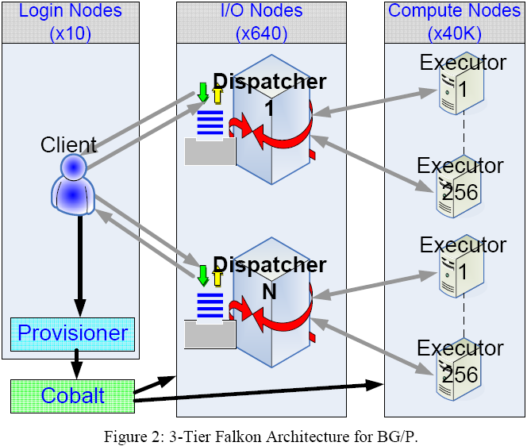
Distributed Falkon Architecture

Slide 17
Reliability Issues at Large Scale
Failure on a single node only affects the task being executed on that node, and I/O node failure affect only their respective psets
Most errors
  Reported to the client(Swift)
  Swift maintains persistent state that allows it to restart a parallel app. script from the point of failure
Others
  Handled directly by Falkon by rescheduling the tasks
Notes:
No need for explicit check-pointing like with MPI apps. It occurs inherently with every task

Slide 18
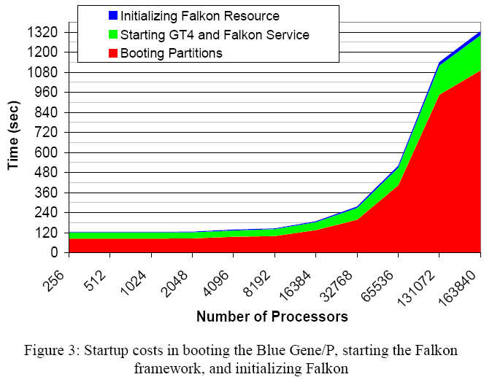
Startup Cost

Slide 19
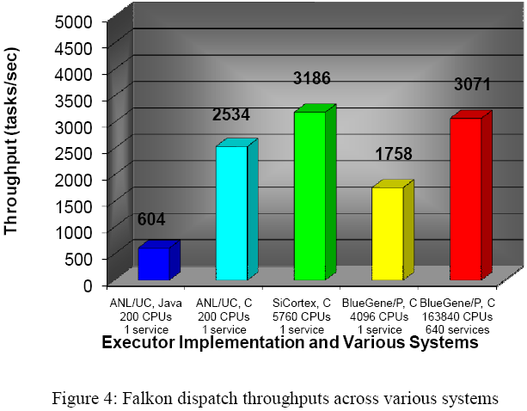
Falkon Task Dispatch Performance

Slide 20
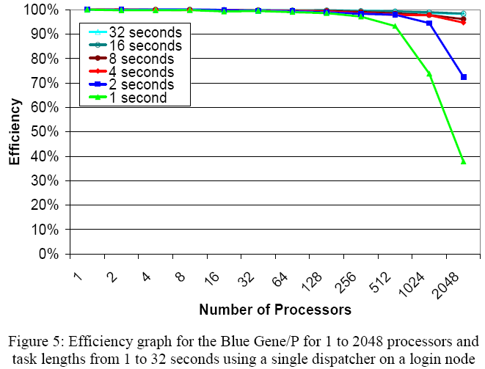
Efficiency and Speedup
(small scale)

Slide 21
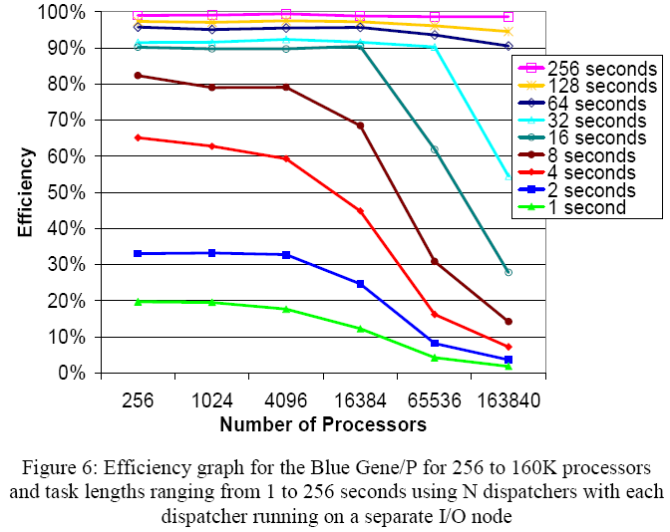
Efficiency and Speedup
(large scale)
Notes:
Distributing Falkon dispatcher: adv. Achieve good scalability to 160K processors
disadv. Significantly worse efficiency at small scales

Slide 22
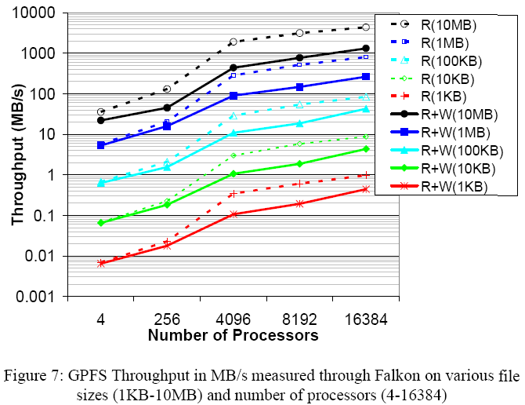
Shared File System Performance
(read and/or write by “dd” utility)
Notes:
GPFS conf: 16 I/O servers, each with 10Gb/s network connectivity, and can sustain 8GB/s aggregate I/O rates
Measures in a production system, where 90%+ of the system was in use by other applications, which might have been using the shared file system as well

Slide 23
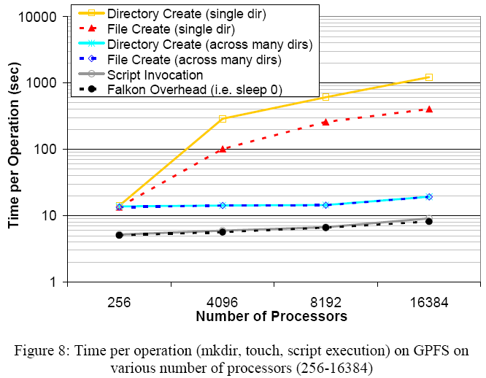
Shared File System Performance
(operation costs)

Slide 24
Molecular Dynamic: DOCK
Screens KEGG compounds and drugs against important metabolic protein targets
  A compound that interacts strongly with a receptor associated with a disease may inhibit its function and act as a beneficial drug
Simulate the “docking” of small molecules, or ligands, to the “active sites” of large macromolecules of known structure called “receptors”
Speeding drug development by rapidly screening for promising compounds and eliminating costly dead-ends

Slide 25
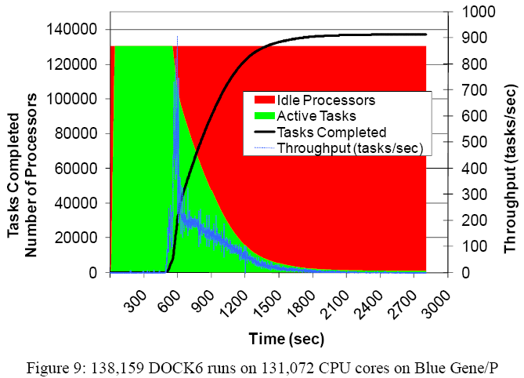
DOCK6 Performance Evaluation

Slide 26
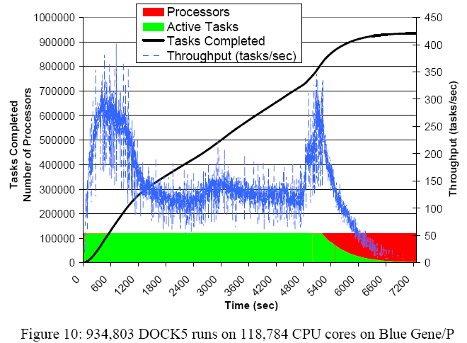
DOCK5 Performance Evaluation

Slide 27
Economic Modeling: MARS
Micro Analysis of Refinery System
An economic modeling app. For petroleum refining developed by D. Hanson and J. Laitner at Argonne
Consists of about 16K lines of C code, and can process many internal model execution iterations(0.5 sec~hours of BG/P CPU time)
The goal of running MARS on the BG/P is to perform detailed multi-variable parameter studies of the behavior of all aspects of petroleum refining

Slide 28
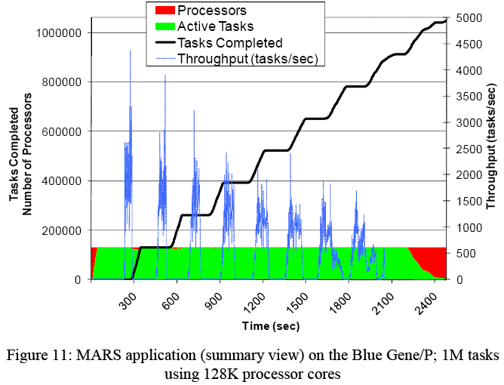
1M MARS tasks on BG/P

Slide 29
Running Apps. Through Swift
Swift can be used
  To make workloads more dynamic, and reliable,
  To provide a natural flow from the results of an app. to the input of following stage in a workflow, making complex loosely coupled programming a reality

Slide 30
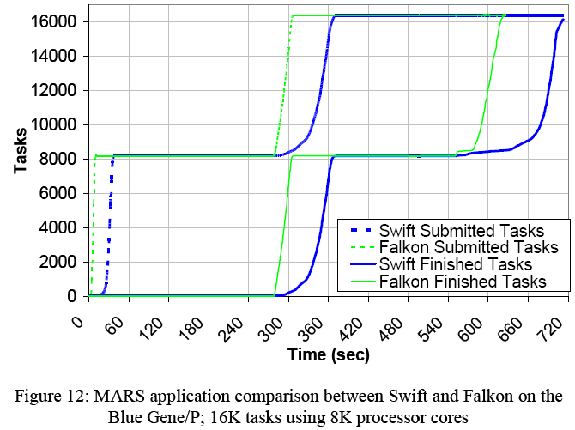
Swift vs Falkon on MARS app.

Slide 31
Swift
Overhead
  Managing the data
  Creating per-task working directories from the compute nodes
  Creating and tracking several status and log files for each task
Optimization
  Placing temporary dirs. in local ramdisk rather than the shared file systems
  Copying the input data to the local ramdisk of the compute node for each job execution
  Creating the per job logs on local ramdisk and copying them only to persistent shared storage at the completion of each job

Slide 32
Conclusions
Characteristics of MTC application suitable for peta-scale systems
  Number of tasks >> number of CPUs
  Average task execution time > O(60 sec) with minimal I/O to achieve 90%+ efficiency
  1 second of compute per processor core per 5~50KB of I/O to achieve 90%+ efficiency

Slide 33
Conclusions(cont.)
Solutions for Main Bottleneck
  Shared file system is accessed throughout system
  Startup cost is insignificant for large application
  Offload to in memory operations so repeated use could be handled completely from memory
  Read dynamic input data and write dynamic output data from/to shared file system in bulk

Slide 34
Future Work
Make better use of the specialized networks on some peta. sys. such as BG/P’s Torus network
  Exploit unique I/O subsystem capabilities
  e.g. collective I/O operations using the specialized high bandwidth and low latency interconnects
Have transparent data management solutions
  To offload the use of shared file sys. resources when local file sys. can handle the scale of data
  Data caching, proactive data replication, data-aware scheduling
Add support for MPI-based apps. in Falkon, the ability to run MPI apps. on an arbitrary number of processors

Slide 35
THE END
QUESTIONS?

